Slide 1

IMAGE CLASSIFICATION USING CONVOLUTIONAL NEURAL NETWORK
Presented by:
Aabhushan Pokharel [44042]
Prabin Bhusal [44057]
Rajesh Mahato [44061]
Supervised by:
Sudhir Shakya,
Founder,
Sorus Nepal Pvt. Ltd.

Slide 2
INTRODUCTION
2

Slide 3
Background
CNN or ConvNet used to solve them
Uses supervised learning to analyze data
Probability generated for each class
Image assigned to highest probability class
78% accuracy achieved in classification
3

Slide 4
Problem Statement
Amount of images ever growing
Impossible to classify all manually
4

Slide 5
Objective
Implement CNN to build image classification system
5

Slide 6
Applications
Automated image organization
In stock photography websites for tagging
In large image databases
6

Slide 7
Features
Classification up to 10 different classes
7

Slide 8
System Requirements
Hardware Requirement
Intel i5 processor (recommended)
8GB RAM (recommended)
Nvidia GPU (optional)
Software Requirement
Windows 7/8/10 64bit or Mac OS X Lion or higher
Python 3.5
Keras 2.1
Sklearn
Numpy
8

Slide 9
LITERATURE REVIEW
9

Slide 10
Literature Review
AlexNet
Used ReLU
Used dropout to selectively ignore neurons during training
Used 11x11 filter[1]
VGG
Introduced concept of smaller filter size
Used 3x3 filters
Allowed more filters to be used[2]
10
Notes:
[1]. A. Krizhevsky, I. Sutskever, and G. E. Hinton, “Imagenet classiﬁcation with deep convolutionalneuralnetworks,”inAdvancesinNeuralInformationProcessingSystems25,F.Pereira,C.J.C.Burges,L.Bottou,andK.Q.Weinberger,Eds. Curran Associates, Inc., 2012, pp. 1097–1105. [Online]. Available: http://papers.nips.cc/ paper/4824-imagenet-classiﬁcation-with-deep-convolutional-neural-networks.pdf
[2]. K. Simonyan and A. Zisserman, “Very deep convolutional networks for largescale image recognition,” CoRR, vol. abs/1409.1556, 2014. [Online]. Available: http://arxiv.org/abs/1409.1556

Slide 11
METHODOLOGY
11

Slide 12
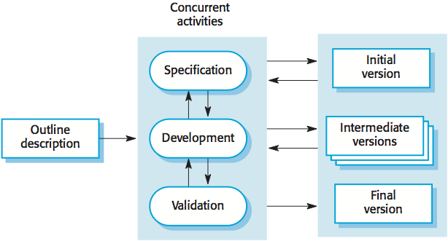
Fig: Incremental Model of Software Development[5]
12
Notes:
[5]. I. Sommerville, Software Engineering, 9th ed. Boston: Addison-Wesley, 2011. [Online]. Available: https://ifs.host.cs.st-andrews.ac.uk/Books/SE9/

Slide 13
Installing the Development Environment
Install Anaconda Distribution
Install tensorflow backend
Create conda environment
Activate conda environment
Install tensorflow
Install Keras Library
13

Slide 14
Algorithm
Start
Load Data
Define image pixel, channel, number of classes and epoch
Perform preprocessing
Define Architecture of Network
Train the model
Visualize and save model configuration
Generate plot of loss and accuracy
Predict the class
Stop
14

Slide 15
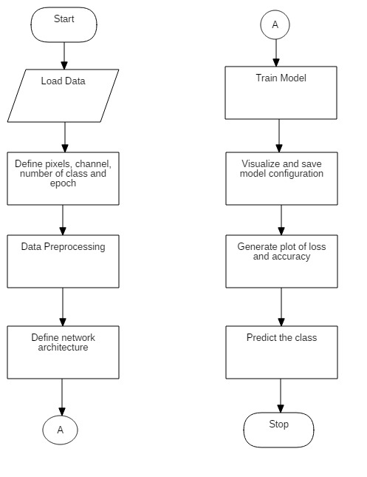
Fig: Flowchart
15

Slide 16


Convolutional Neural Network
Convolutional Layer
W=width, h=height, F_{w}=filter width, F_{h}=filter height, S=Stride[3]
Max-Pooling
Follows pair of convolutional layer
Takes single output from a rectangular field
In this case, maximum value in the field
16
Notes:
[3]. “Cs231n convolutional neural networks for visual recognition,” Cs231n.github.io, 2018. [Online]. Available: https://cs231n.github.io/convolutional-networks/ [Accessed: 03-Mar-2018].

Slide 17

Convolutional Neural Network
ReLU
Rectified Linearity Unit
Output is 0 if input is less than 0
Softmax
Squashes output to be between 0 and 1 and sums to 1
Where z = vector of inputs to output layer and j=1,2,...,K[4]
17
Notes:
[4]. “Relu and softmax function,” github.com, 2017. [Online]. Available: https://github.com/Kulbear/deep-learning-nano-foundation/wiki/ ReLU-and-Softmax-Activation-Functions [Accessed: 20-May-2018].

Slide 18
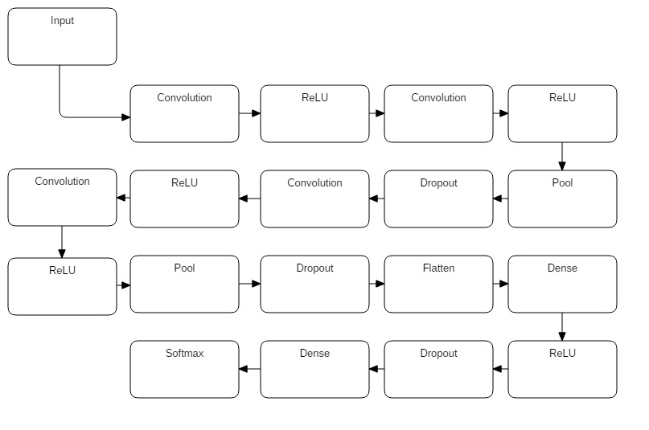
Fig: Model Diagram
18

Slide 19
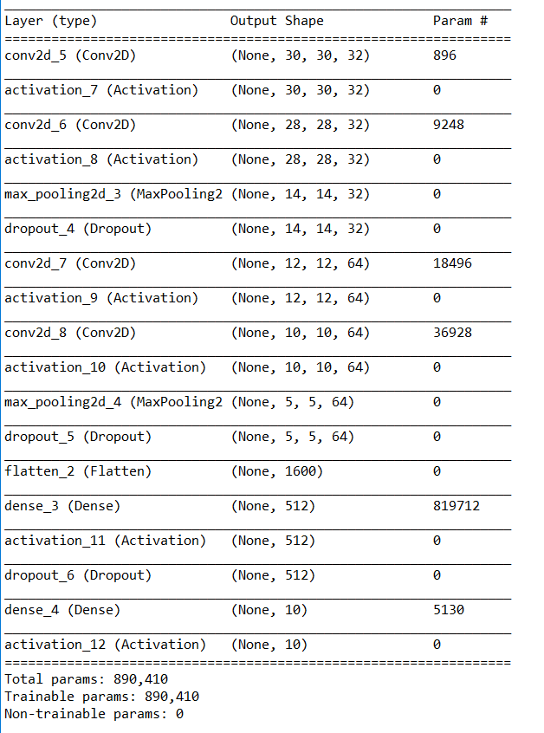
Table: Model Summary
19

Slide 20
Model Implementation
Model trained for 30 epochs
Batch size = 128
Checkpoint and early stop applied
Model configuration stored in .json file format
Training weights stored in .h5 file format
Cifar-10 dataset used
For version summary see page 20 in the report
20

Slide 21
RESULTS AND DISCUSSION
21

Slide 22
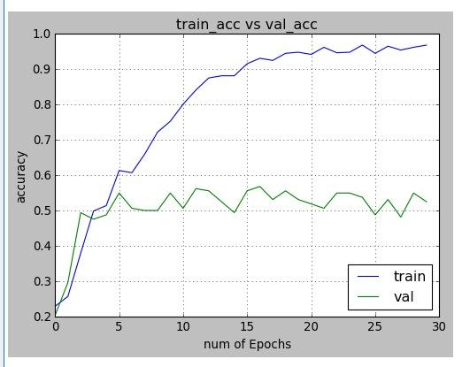
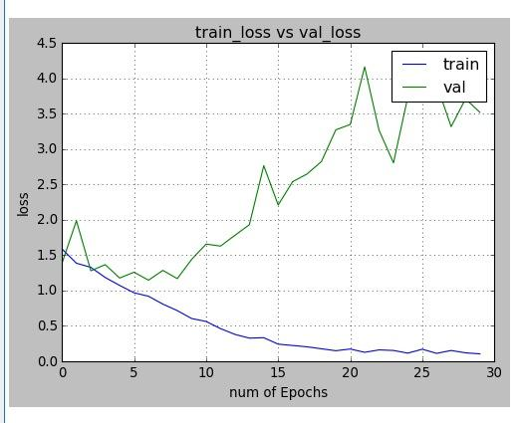
Fig: Previous Output (Build 1)
22

Slide 23
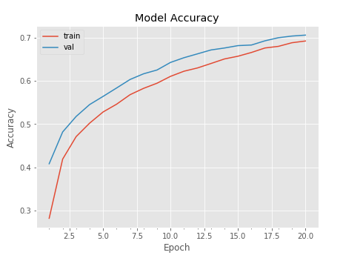
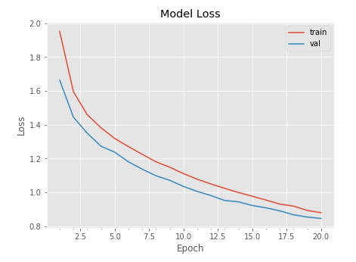
Fig: Previous Output (Build 2)
23

Slide 24
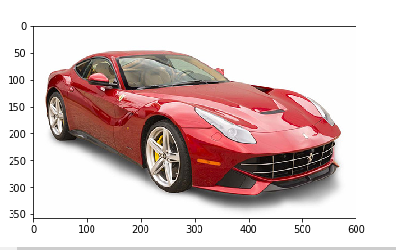
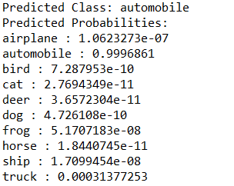
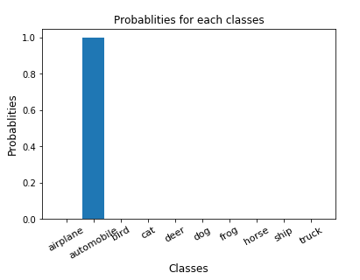
Fig: Current Output (Automobile)
24

Slide 25
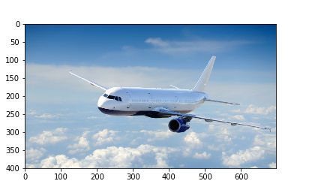
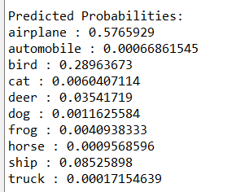
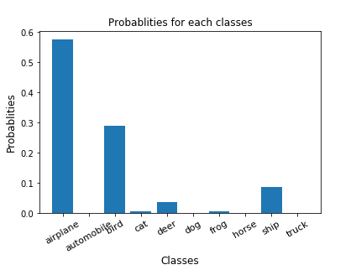
Fig: Current Output (Airplane)
25

Slide 26
Parameter | Value
Number of epochs | 30
Learning rate | 0.01
Decay | 10⁻⁶
Momentum | 0.9
Batch size | 128
Filter number | 32/32/64/64
Dropout value | 0.25/0.5
Number of classes | 10
Train:test ratio | 5:1
Discussion
Train time 163 minutes
Accuracy: 78%
Training parameters not listed set by using SGD optimizer
26

Slide 27
Limitations
Need to be retrained from scratch if new data is to be added to training dataset
Can only classify mutually exclusive images
27

Slide 28
CONCLUSION
28

Slide 29
Conclusion
CNN chosen for higher accuracy
Accuracy improved from 54%, 69% and concluded at 78%
Optimum combination of datasets, Architecture, Training parameters results in better prediction
Helps to understand the concepts of classification problems
29

Slide 30
Scope for Future Enhancement
Further tune the model to push accuracy above 85%
Increase the number of classification classes with dataset
30

Slide 31
References
A. Krizhevsky, I. Sutskever, and G. E. Hinton, “Imagenet classiﬁcation with deep convolutionalneuralnetworks,”inAdvancesinNeuralInformationProcessingSystems25,F.Pereira,C.J.C.Burges,L.Bottou,andK.Q.Weinberger,Eds. Curran Associates, Inc., 2012, pp. 1097–1105. [Online]. Available: http://papers.nips.cc/ paper/4824-imagenet-classiﬁcation-with-deep-convolutional-neural-networks.pdf
K. Simonyan and A. Zisserman, “Very deep convolutional networks for largescale image recognition,” CoRR, vol. abs/1409.1556, 2014. [Online]. Available: http://arxiv.org/abs/1409.1556
“Cs231n convolutional neural networks for visual recognition,” Cs231n.github.io, 2018. [Online]. Available: https://cs231n.github.io/convolutional-networks/ [Accessed: 03-Mar-2018].
“Relu and softmax function,” github.com, 2017. [Online]. Available: https://github.com/Kulbear/deep-learning-nano-foundation/wiki/ ReLU-and-Softmax-Activation-Functions [Accessed: 20-May-2018].
I. Sommerville, Software Engineering, 9th ed. Boston: Addison-Wesley, 2011. [Online]. Available: https://ifs.host.cs.st-andrews.ac.uk/Books/SE9/
31

Slide 32
Thank You
32

